Slide 1
Financial Data Analysis
Matthew Bates & Sankeerti Haniyur

Slide 2
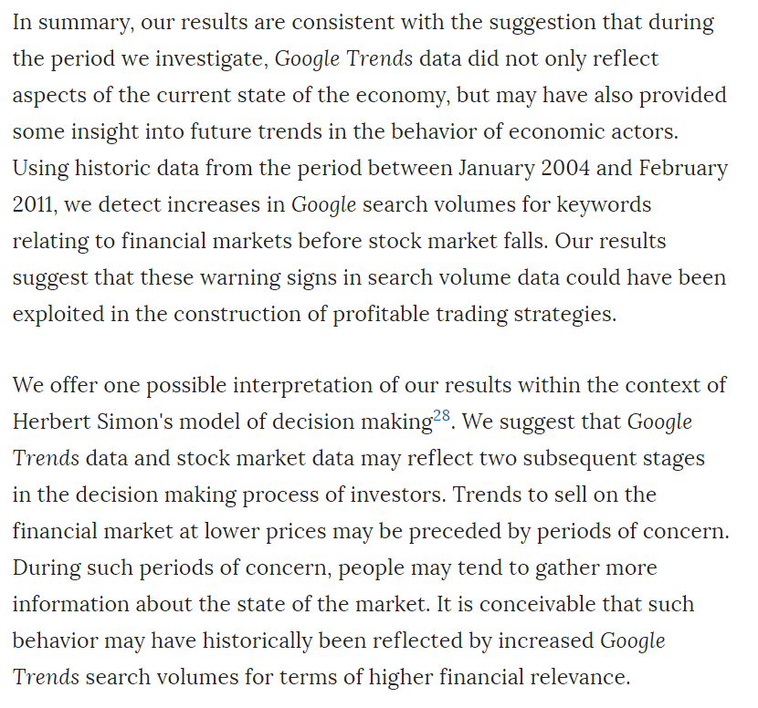
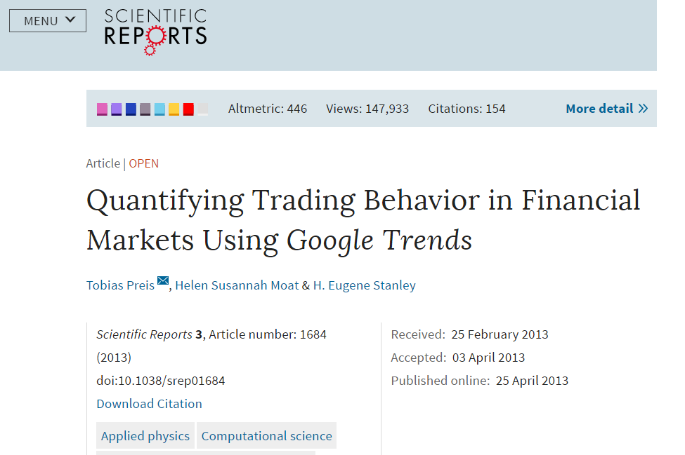
Introduction
Idea came from our mutual interest in financial analysis
Read a few research papers about predicting stock market trends using search engine data
Source: "Quantifying Trading Behavior in Financial Markets Using Google Trends" by Tobias Preis, Helen Susannah Moat & H. Eugene Stanley -

Slide 3
Methodology
Calculate weekly averages
Explore
Prediction
Google Trends
Yahoo Finance
Obtain Data
Manipulate
Correlation between stock price & search results
Determine optimal lags
Account for holidays
Calculate returns
Identify weeks with greatest losses

Slide 4
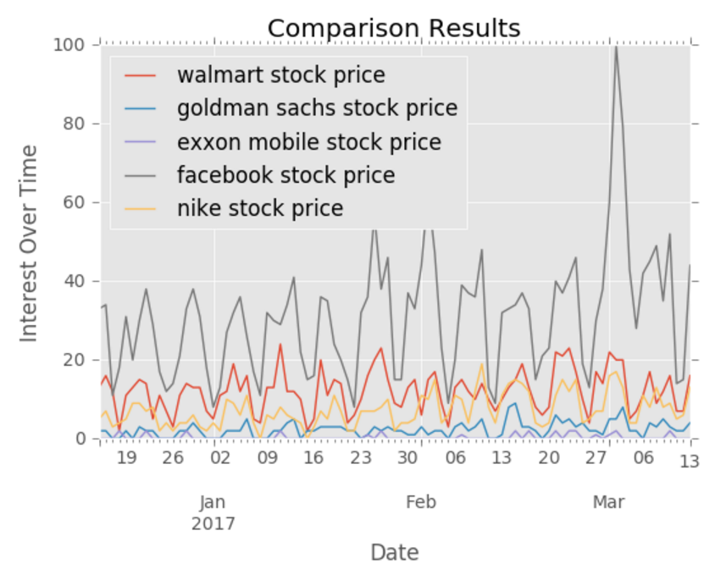
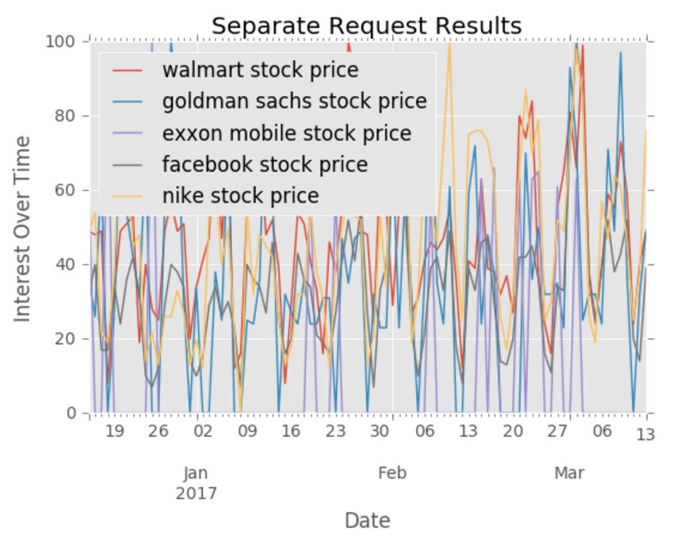
Data: Google Trends
Used an unofficial API – pytrends
Initially observed weekly pattern in data

Slide 5
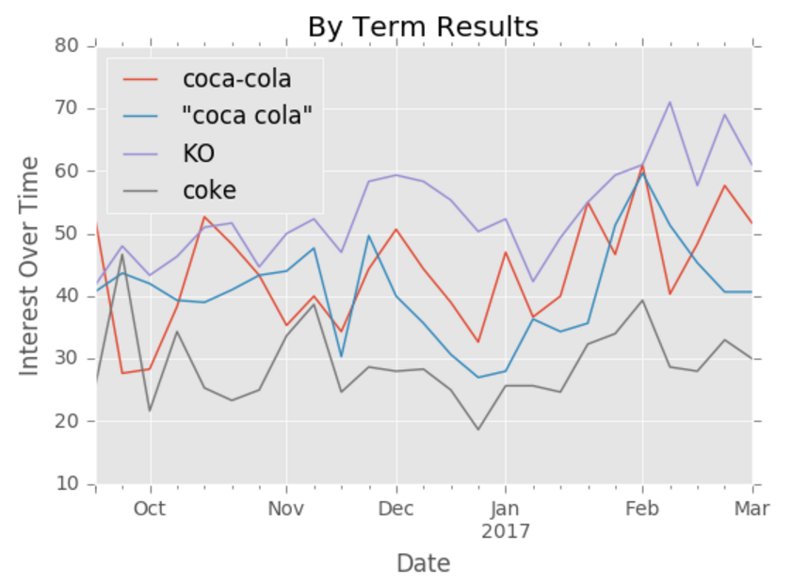
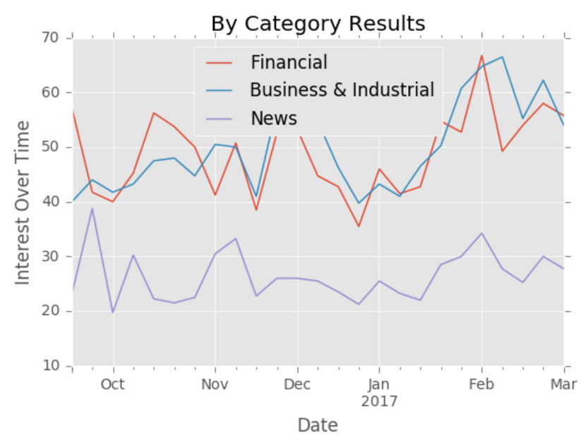
Data: Google Trends
Use weekly data to smooth over weekday vs weekend search frequency spikes.
Decided to focus on one company for demonstration: Coca-Cola
Search terms: coca-cola, coca cola, KO, coke
Obtained weekly results per term for last 3 years
3 search-term categories of focus: Financial, Business & Industrial, News

Slide 6
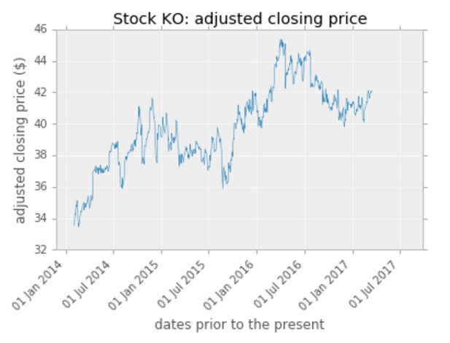
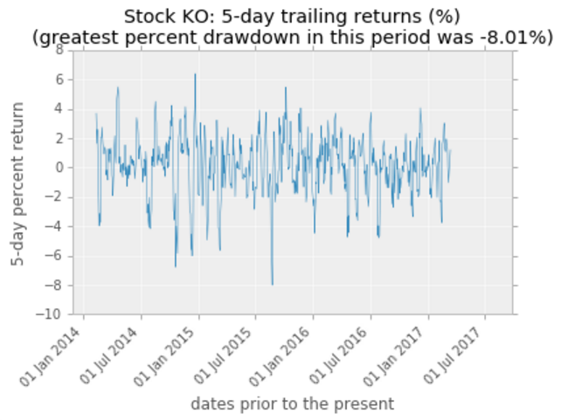
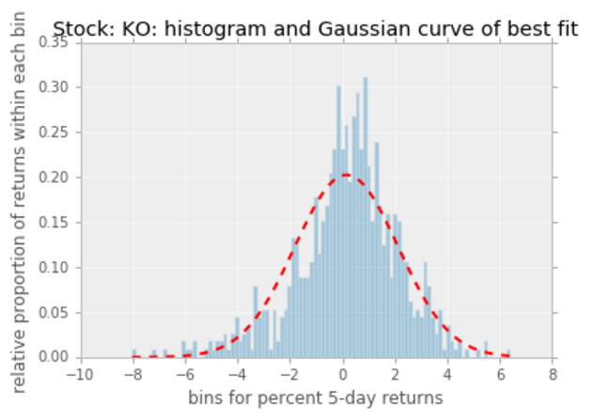
Data: Yahoo Finance
Used lognormal distribution and percent returns to describe stock data
N-day percent trailing returns
Below are results for Coca-Cola, 5-day trailing returns, calculated daily

Slide 7
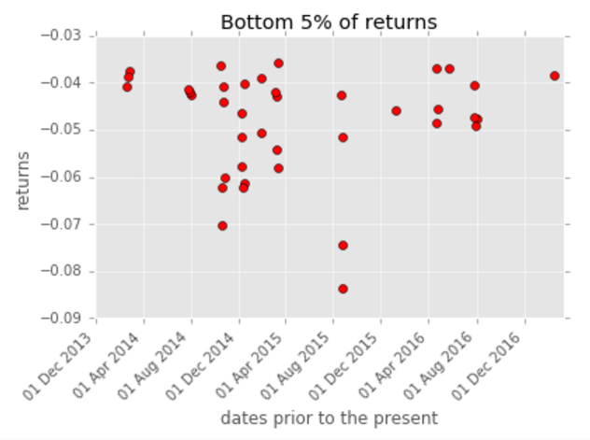
Data: Yahoo Finance
Calculated average returns per week to match Google Trends data
Created a binary time series for only most substantial losses
Ex: 0 0 0 0 1 0 0 0 1 0 0

Slide 8
Manipulate:

Slide 9
Explore: Calculate Correlation
For n-lags, we calculated the correlation between the two time series

